Slide 1
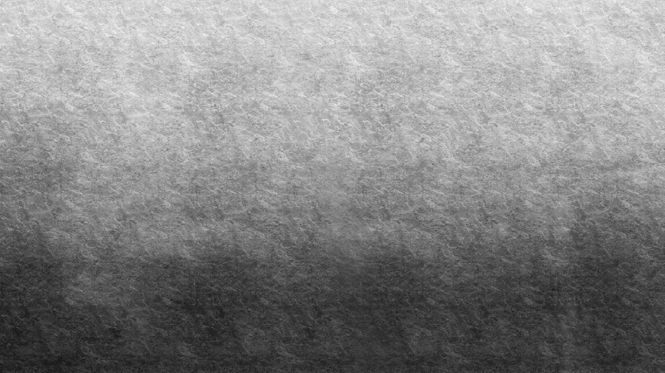
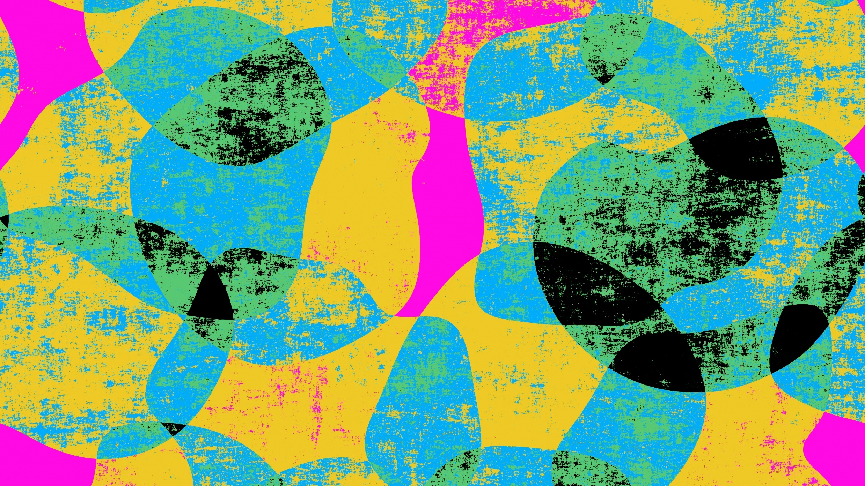
Artistic Style Transfer
Austin Hester CS 6420 – Image Processing Prof. Sanjiv Bhatia University of Missouri – St. Louis

Slide 2
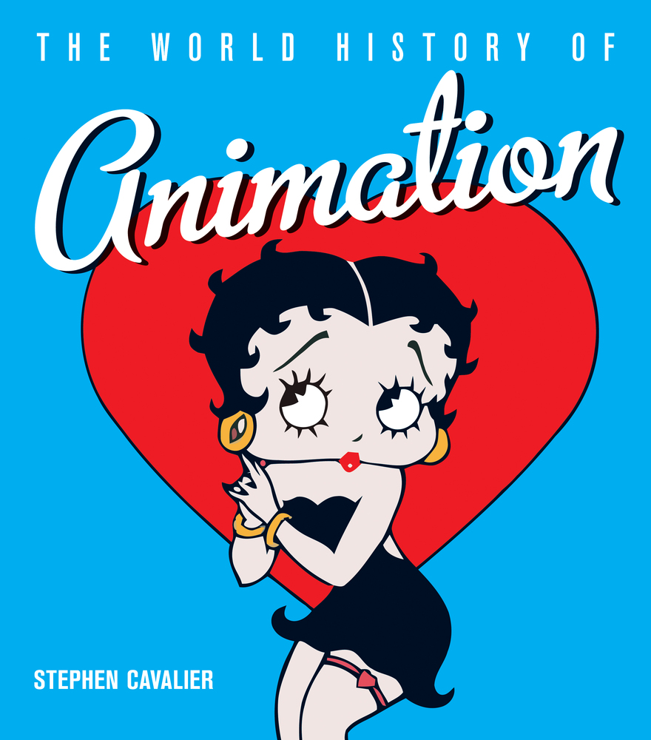
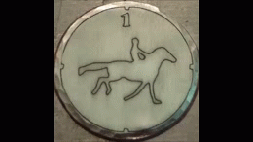
History
In the late 19th century, Eadweard Muybridge’s horse sequences were painted on glass discs.
These discs were used in a special projector called a zoopraxiscope, which they display in the bug-house at the St. Louis Zoo.
Also in the late 19th century, Claymation appears.
Pros: Real-life lighting, more concrete scenery.
Cons: Tedious, need a lot of clay.
In 1915, Max Fleischer invents Rotoscoping, which inspires many future animators.
Computer-Generated Imagery (CGI) first used in 1986 for Flight of the Navigator.

Slide 3
Rotoscoping Timeline
1915
Max Fleishcher invents Rotoscoping, known back then as the “Fleishcher Process.”
1918
Fleischer's animated series Out of the Inkwell (1918-1927) starring Koko the Clown.
1934
Fleischer’s patent expires. Other studios begin using rotoscoping and a flood of animated works hit the silver screen.

Slide 4
Advantages of Rotoscoping
Efficiency
Motion Accuracy
Animation takes a long time.
Rotoscoping makes this easier by providing a(n) image(s) to trace on top of.
Much more natural motion, since movement is traced from a real person.

Slide 5
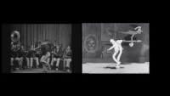

Slide 6
Problem Statement
Animation takes too gosh dang long.

Slide 7
Project Focus
What is style transfer?
What is it good for?
Why single frame?
Why not video?
Focus on single-frame style transfer.

Slide 8
Implementation: Pre-process
Apply GuassianBlur
Convert to HSV
[optional] Split into quadrants.

Slide 9
Implementation: Process
Register the template image to the target image.
Split HSV into planes.
For each quadrant:
Extract ROIs for hue, saturation, and value of template and target.
Resize template quadrant to target quadrant.
Blend each channel independently into output image planes
Merge output planes together.
Convert back to RGB.

Slide 10
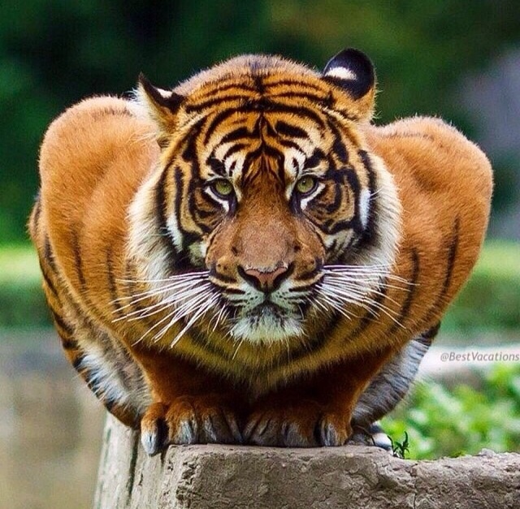
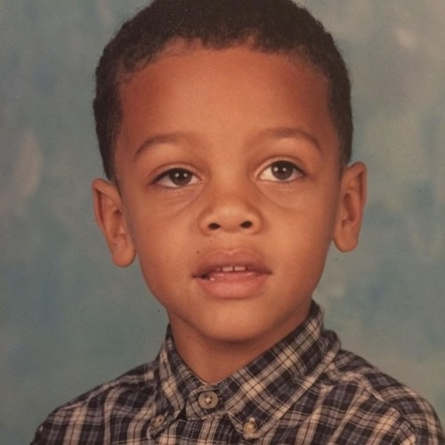
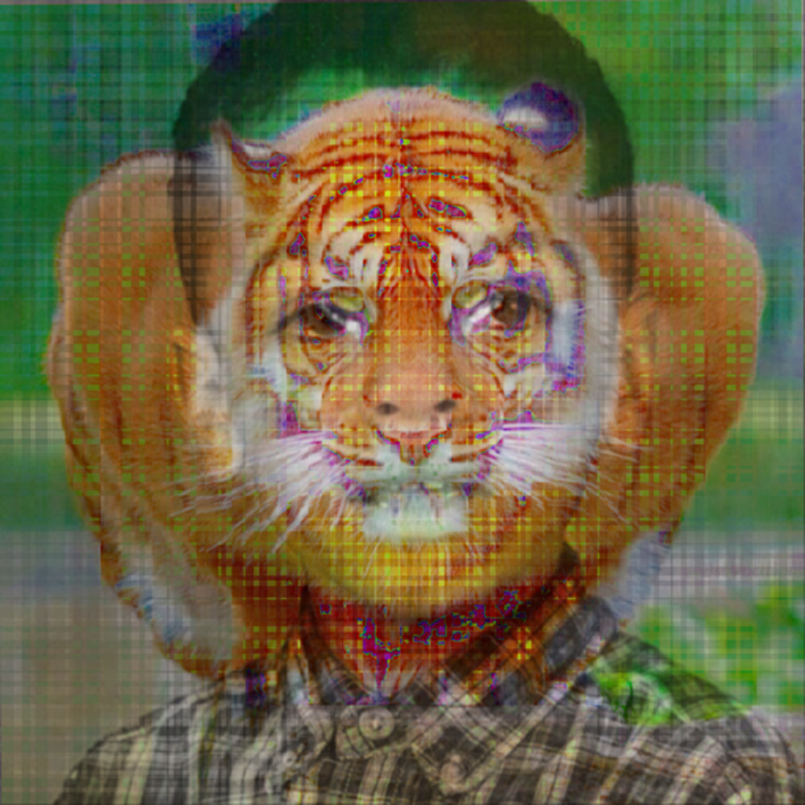
Example of Implementation
Template Image
Target Image
My Result

Slide 11
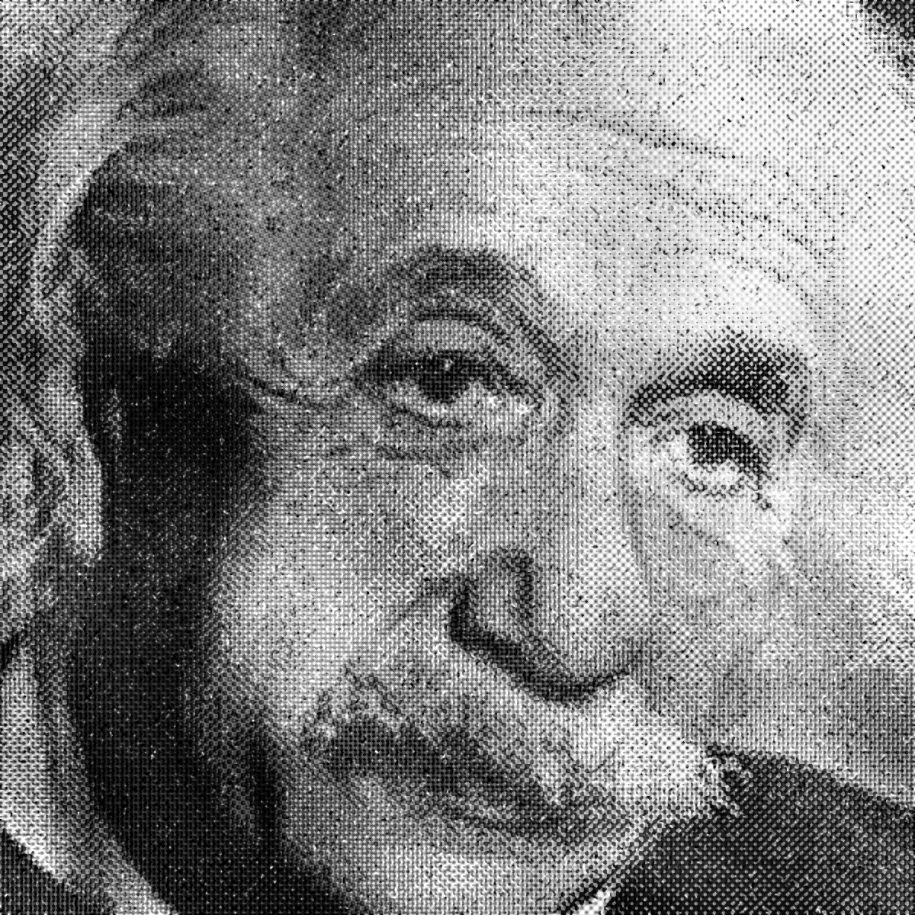
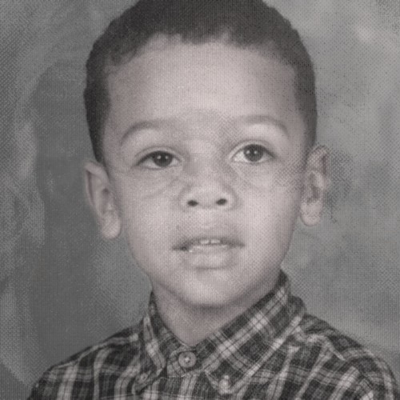
Example of Implementation
Template Image
Target Image
My Result

Slide 12
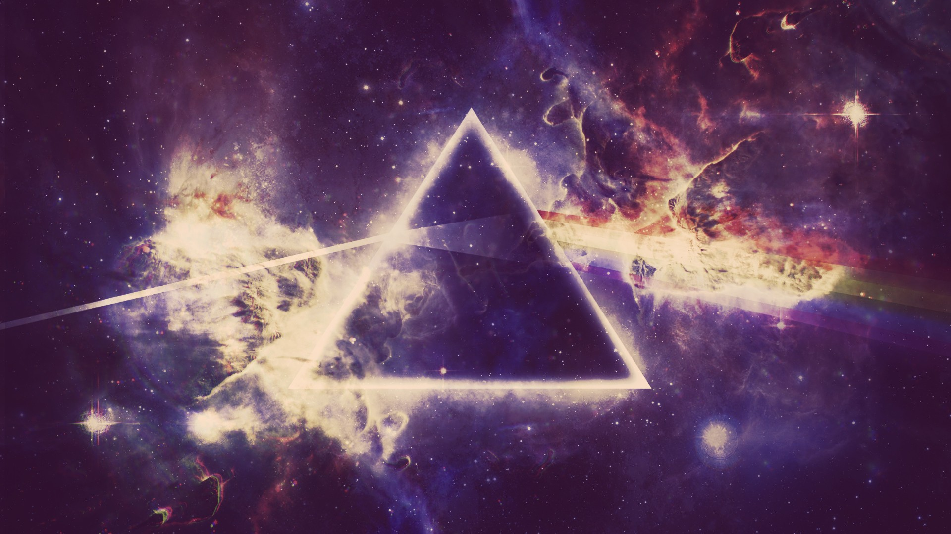
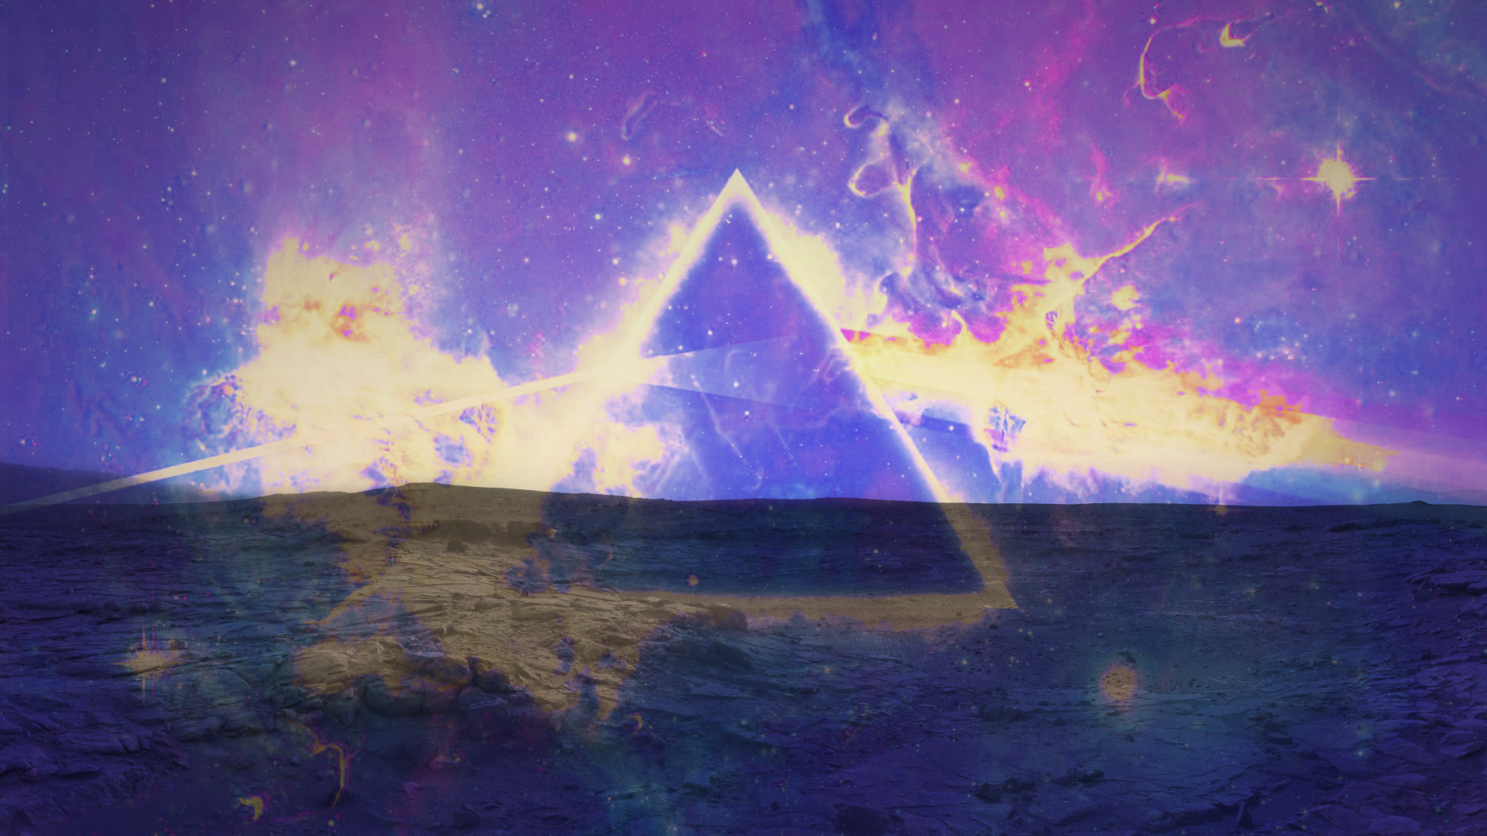
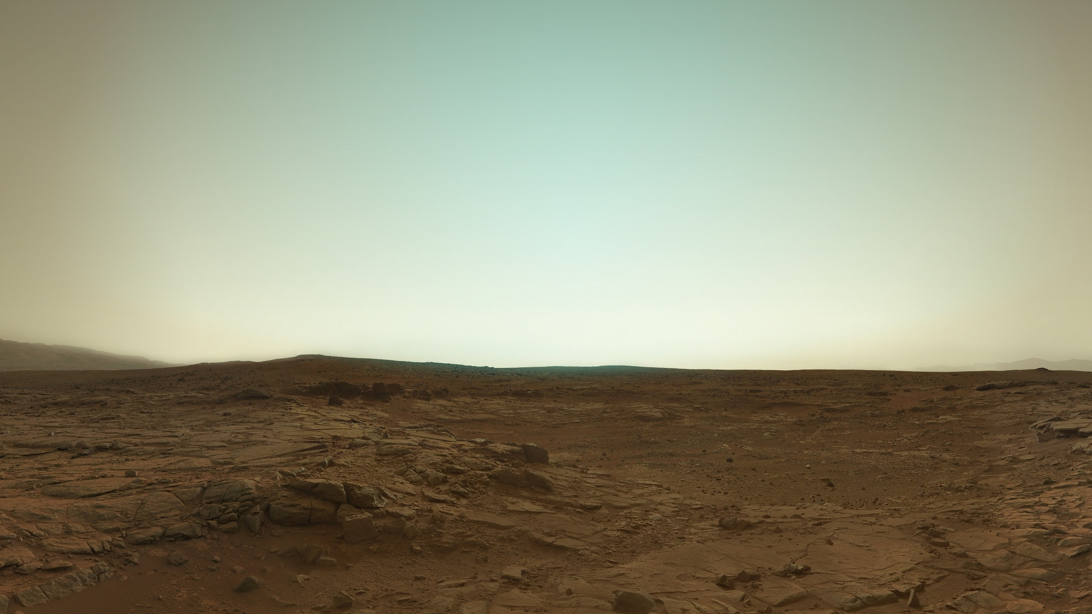
Example of Implementation
Template Image
My Result
Target Image

Slide 13
Problems Faced: Artistic Detail
Artistic styles with fine details are harder to transfer due to averaging and warping.
Artists depict a “mood,” which can be difficult to transfer to a target image.
Textures are difficult to transfer for the same reason as fine details.

Slide 14
Problems Faced: Identity Preservation
Need to transfer artistic style from source image to target image, while preserving the identity of the target.
e.g. Source image: Mona Lisa. Target image: Bill Gates.
We want our target image, Bill Gates, to be drawn in the same style as Mona Lisa, but the output image should still be identifiable as a portrait of Bill Gates.
Preserve attributes such as the shape, size, and position of facial features.

Slide 15
Problems Faced: Indecision
As I was learning more in class, my idea on how to implement a solution kept changing.
I ended up watching output-result videos, in awe, for far too long.
Other out-of-scope problems include client launches at work and the map project(s) taking a lot of time.
The class projects did help a lot in teaching me OpenCV enough to get some results from my implementation.

Slide 16
Problems Faced: Video
Temporal cohesion is when an object maintains its identity from frame-to-frame.
Optical Flow, offered by OpenCV, aims to identify and track objects throughout a sequence of frames.

Slide 17
Example-Based Synthesis of Stylized Facial Animations
This is the paper that motivated me to choose artistic style transfer as my topic.
Does NOT use neural networks to transfer style.
Maintains temporal cohesion, maintains identity of target image, and retains artistic style in more detail.
Implementation known as “ebsynth.”
Jamriška. Fišer, et al., (ACM Transactions on Graphics 2017). https://dl.acm.org/doi/10.1145/3072959.3073660

Slide 18
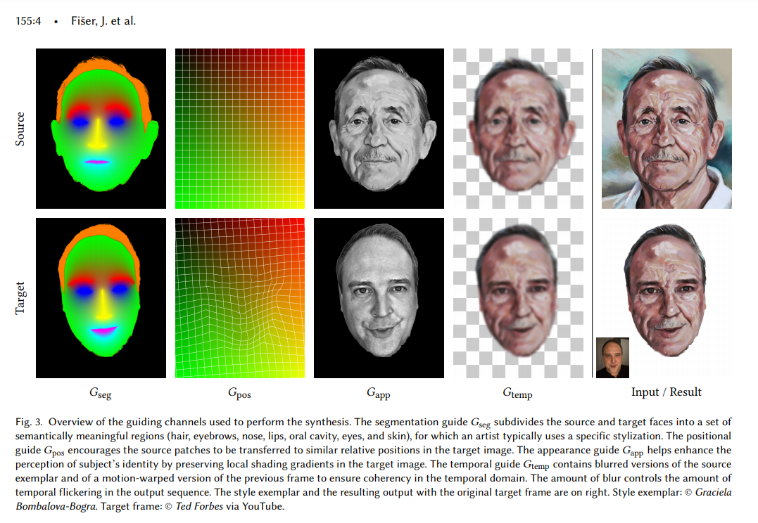
Positional Guide

Slide 19
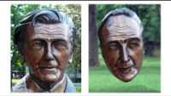

Slide 20
FaceBlit: Instant Real-time Example-based Style Transfer to Facial Videos
FaceBlit is a technology that aims to provide real-time facial style transfer, running on a smartphone CPU.
It uses positional guides, semantic (style) guides, image registration, histogram matching, among other techniques to achieve results.
In order to make real-time work, they use a 3D lookup table for values of Red, Green, and Gray.
Uses the same positional guides as Example-Based Synthesis…, but generates these guides:
Using a linear approximation in order to support real-time results.
Texler et al., (Proceedings of the ACM on CGIT April 2021). https://dl.acm.org/doi/10.1145/3451270

Slide 21
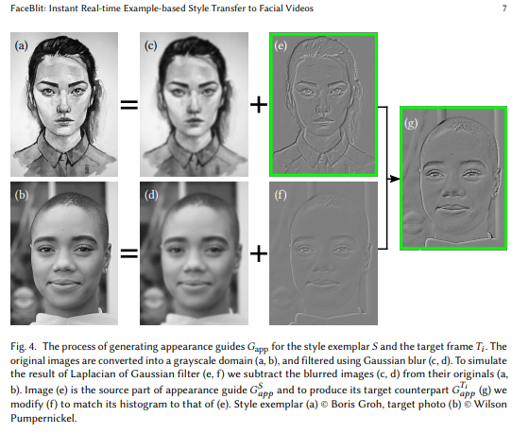
Appearance Guide

Slide 22
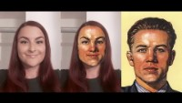

Slide 23
Futschik et al., STALP: Style Transfer with Auxiliary Limited Pairing
This work was released May 1, 2021. I did not have time to research these improvements, but we can see the progress made by this research team in the video on the next slide.

Slide 24
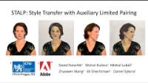

Slide 25
References
Daniel Sýkora, author on many papers listed here, has a website with much related work: https://dcgi.fel.cvut.cz/home/sykorad/
[1] Cavalier, Stephen. The World History of Animation. ISBN:9780520261129. (Aurum 2011). https://www.ucpress.edu/book/9780520261129/the-world-history-of-animation
[2] Futschik et al., STALP: Style Transfer with Auxiliary Limited Pairing (Eurographics May 2021). https://dcgi.fel.cvut.cz/home/sykorad/Futschik21-EG.pdf
[3] Jamriška et al., Example-Based Synthesis of Stylized Facial Animations (ACM Transactions on Graphics 2017). https://dl.acm.org/doi/10.1145/3072959.3073660 https://github.com/jamriska/ebsynth
[4] Texler et al., FaceBlit: Instant Real-time Example-based Style Transfer to Facial Videos (Proceedings of the ACM on CGIT April 2021). https://dl.acm.org/doi/10.1145/3451270 https://github.com/AnetaTexler/FaceBlit

Slide 26
